Slide 1
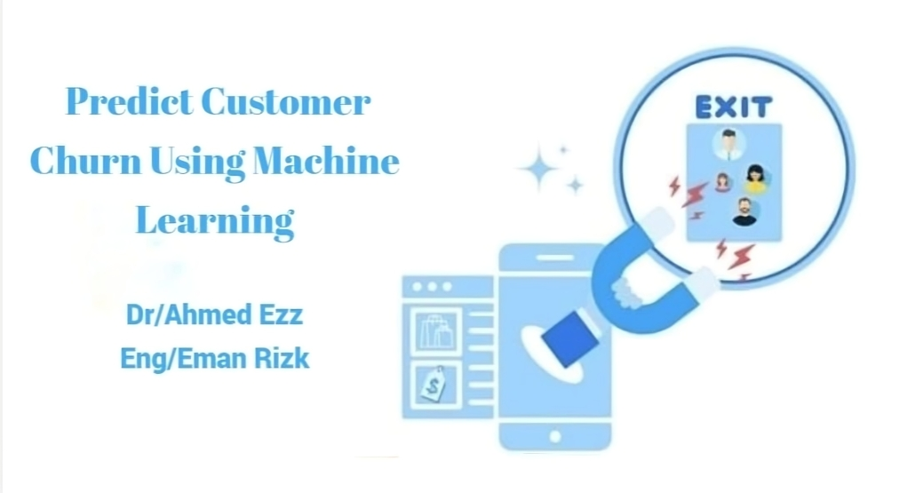


Slide 2
2
This graduation project is By:
1-Kareem Gamal Rady | 20-00722
2-Youssef Tharwat Wadea | 20-00441
3-Aya Mohammed Abdelnaby | 20-00896
4-Yostina Samy Dawood | 20-00384
5-Yostina Maged Nassef | 20-00713
6-Shrouk abdelal Ali | 20-01312
7-Suhaib Emad Mohamed | 20-01546
ID
Name

Slide 3
3
Outline
Introduction
Problem Statement
Features
Difference between Linear Regression and Logistic Regression and Cox Regression
Survival Analysis
Four Level Analytics
Data Understanding
Objectives And Approach
Future Work
Conclusions
References

Slide 4
4
01
Introduction

Slide 5
5
A project that aims to analyze customer behavior and predict whether they will leave a particular service or product in the near future. Estimating customer churn is vital for any business, as customer churn can significantly impact revenue and reputation.
Customer churn occurs when customers or subscribers stop doing business with a company or service.
Also known as customer attrition, it is a very important metric because retaining existing customers is much less expensive than acquiring new ones.
Introduction

Slide 6

6
It's a critical issue for businesses across various industries because retaining existing customers is often more cost-effective than acquiring new ones.
We will also talk about the solutions proposed to solve the problem and the methods used in doing so The solution to the problem will be analyzed using one of the methods of survival analysis, which is Cox- Regression.
Introduction

Slide 7
7
Problem Statement
02

Slide 8
8
The churn problem related to the loss of customers or subscribers from dealing with the company during a certain period.
This is due to the fact that the customer is not satisfied with the service that we provide, or because there are competitors who provide this service better than me or cheaper, or perhaps the needs of customers change and I do not keep up with this change, or customer service is not good, or the quality of the product, or the presence of better alternatives, or previous negative experiences.
Problem
Statement

Slide 9
9
The problem of customer change, or what is known as “Churn”, has noticeable negative effects on companies and businesses, and includes loss of revenue, costs of acquiring new customers, a negative impact on the reputation and public image of the company, weakening of the lifetime value of customers, and loss of future sales opportunities
Overall, customer churn can have significant negative impacts on businesses, so managing this issue effectively is crucial to maintaining company growth and sustainability.
Problem
Statement

Slide 10
10
There are many solutions that can be relied upon to address the problem of customer crowding and reduce the loss rate, and these solutions include improving the quality of the product or service, improving customer service, loyalty and rewards programs, customizing offers and services, analyzing data and predicting change, and directing social communication, distinguished customers to change.
Keeping these solutions in mind, companies can increase their customer growth rate and loyalty, making them effective in sustainable growth.
Problem
Statement

Slide 11
11
03
Features

Slide 12
12
There are many attributes that can be used to predict customer churn using machine learning techniques. These attributes typically include a variety of factors that can influence a customer's decision to stay or leave.
These attributes include historical customer behaviors, demographics and personal information, recent customer activities, interaction with technical support and customer service, financial information, changes in behavior, interaction with offers and promotions, and personal estimates and expectations.
Features

Slide 13
13
Analyzing these traits and using them in machine learning models can help companies identify customers who may be on the verge of abandoning them, allowing them to engage with them effectively and take action to retain them.
Features

Slide 14
14
Difference between Linear Regression and Logistic Regression and
Cox Regression
04

Slide 15
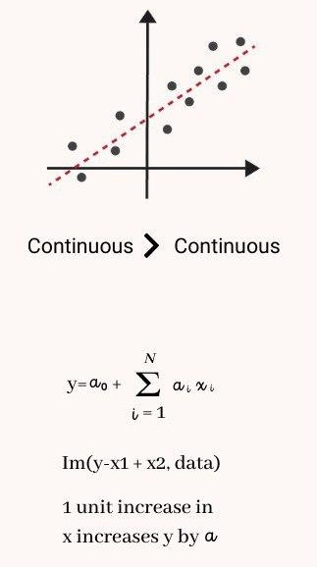
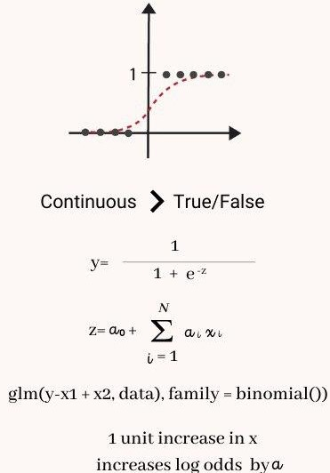
Difference between Linear Regression and Logistic Regression and Cox Regression
15
Linear Regression | Logistic Regression | Cox Regression
Linear regression is used for predicting a continuous outcome variable based on one or more predictor variables. Outcome Variable: The dependent variable is continuous and can take any real value. | Logistic regression is used for binary or multinomial classification problems, predicting the probability of an observation belonging to a particular class. Outcome Variable: The dependent variable is binary (two classes) or multinomial (more than two classes), and the prediction is transformed using the logistic function | Cox regression is used for survival analysis, modeling the time until an event of interest occurs. Outcome Variable: The dependent variable is the survival time or time until an event occurs.

Slide 16
16
Survival Analysis
05

Slide 17
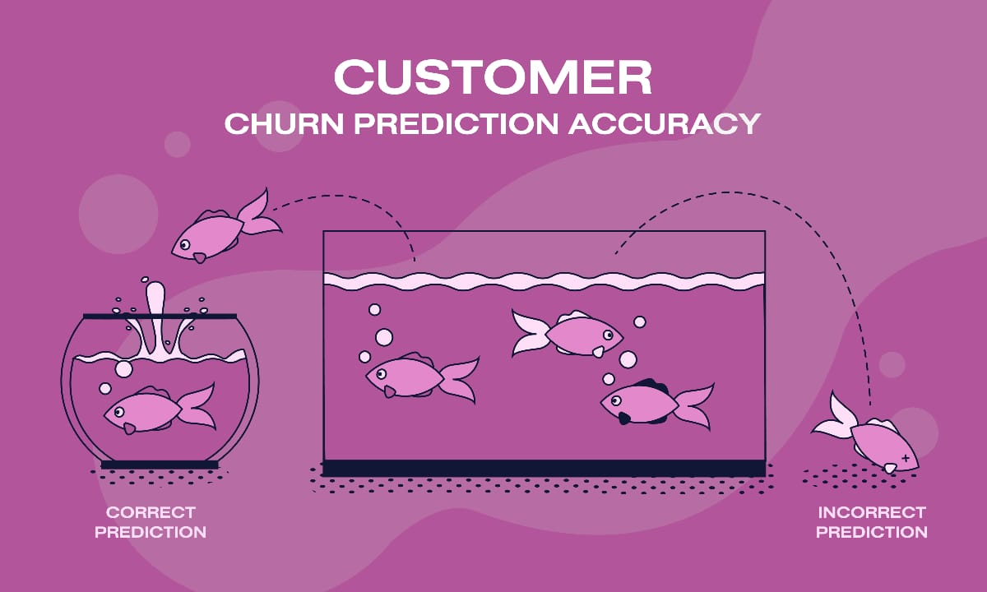
Survival Analysis
17
Survival analysis in telecommunications helps understand customer behavior and service use, identifies factors affecting retention, and improves service offerings and retention strategies.
Customer Satisfaction Assessment
Identifying Influencing Factors
Improving Customer Experience
Enhancing Retention Strategies
Guiding Marketing Strategies
Achieving More Revenue

Slide 18
18
Four Level Analytics
06

Slide 19
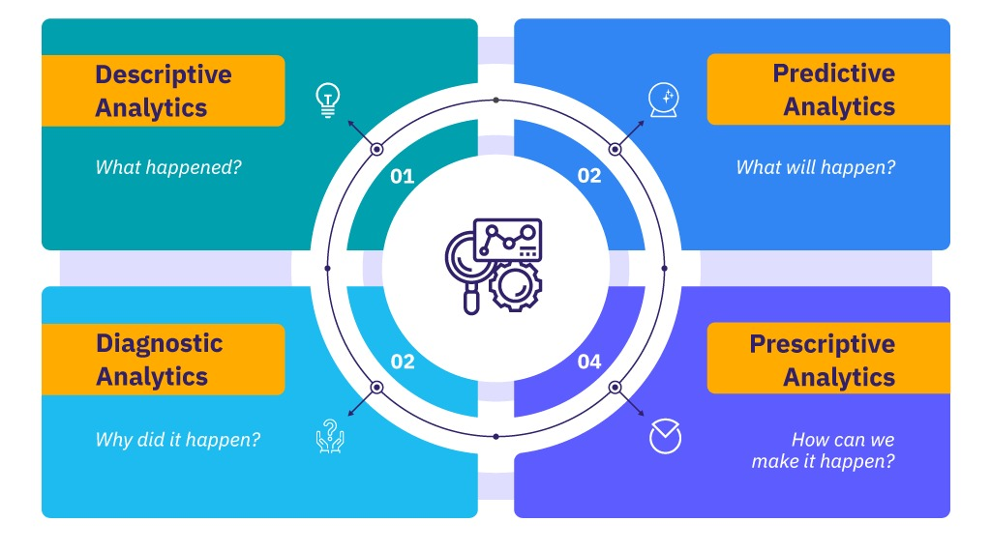
Four Level Analytics
19

Slide 20
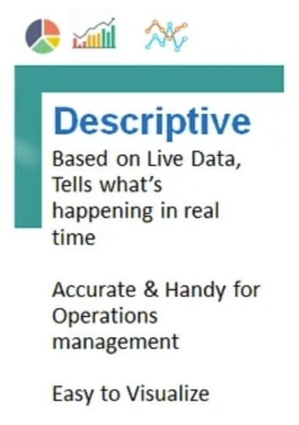
Descriptive Analytics
20
Descriptive analytics, or business intelligence, uses historical information to answer the question “What Happened?”

Slide 21
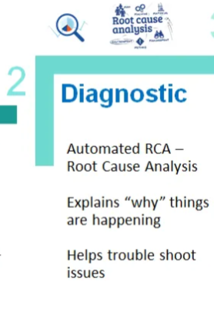
Diagnostic Analytics
21
Diagnostic analytics is a form of data analytics that examines data or content to answer the question, “Why did it happen?”

Slide 22
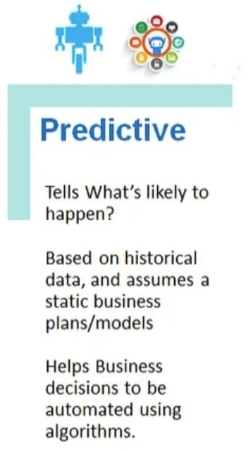
Predictive Analytics
22
Predictive analytics examines current and historical data patterns to determine if they are likely to reoccur.
This enables businesses and investors to adjust resource allocation to capitalize on potential future events.
Predictive analytics can also improve operational efficiencies.
It can reduce risk.

Slide 23
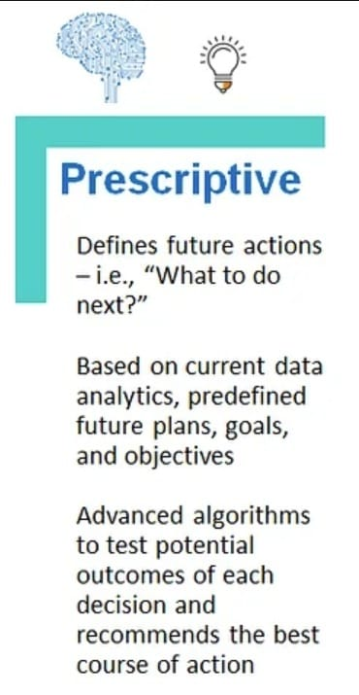
Prescriptive Analytics
23
Uses both descriptive and predictive analytics.
Focuses on actionable insights.
Prioritizes decision-making over data monitoring.

Slide 24
24
Data Understanding
07

Slide 25
Data Understanding
25
We also would like to understand why the model thinks our customers churn, and for that, we need to be able to interpret the model’s predictions. We will use data from https://www.kaggle.com/datasets/blastchar/telco-customer-churn
Data Description 7043 observations with 20 variables
This table shows some of the variable:
Data filed | Description
Gender | Male , Female
Senior Citizen | Yes , No
Partner | Yes , No
Dependents | Yes , No
Paperless Billing | Yes , No
Streaming Movies | Yes, No Internet Service , No
Phone Service | Yes , No
Internet Service | DSL, Fiber optic , No

Slide 26
Data Understanding
26
This table shows some of the variable:
Data filed | Description
Multiple Lines | No, No Phone Service , Yes
Tech Support | No , No Internet Service, Yes
Online Backup | No , No Internet Service, Yes
Streaming TV | No , No Internet Service , Yes
Device Protection | No, No Internet Service , Yes
Payment Method | Bank transfer , credit card
Device Protection | No , No Internet Service , Yes
Churn | Yes , No
Time | Month to month . One year . Two year, three year

Slide 27
27
Objectives And Approach
08

Slide 28
28
Our goals can be summarized as follows:
Data Analysis
Data collection
Data cleaning
Feature extraction
Identifying important attributes
Develop forecasting models
Choosing the appropriate model
Model training
Model Evaluation
Model testing
Model improvement
Model application
Churn prediction
Retention Strategies
By combining goals and approach, a company can build a robust system for anticipating customer churn and taking proactive actions to retain them, contributing to improved financial performance and enhanced customer loyalty.

Slide 29
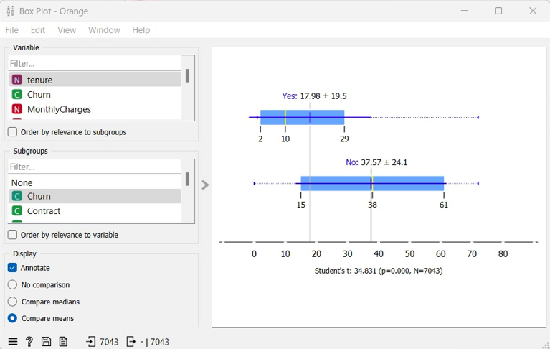
29
Box Plot
Tenure and Churn

Slide 30
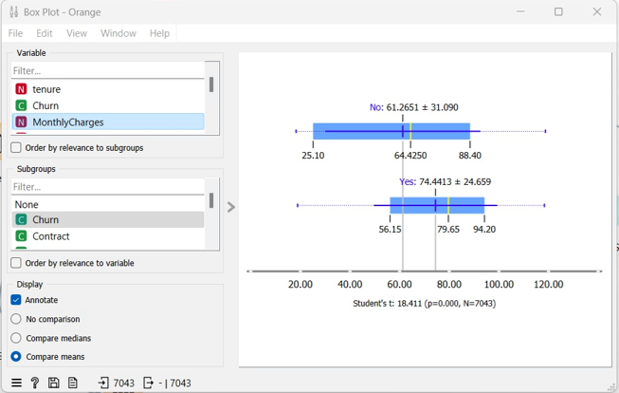
30
Box Plot
Monthly Charges
and Churn

Slide 31
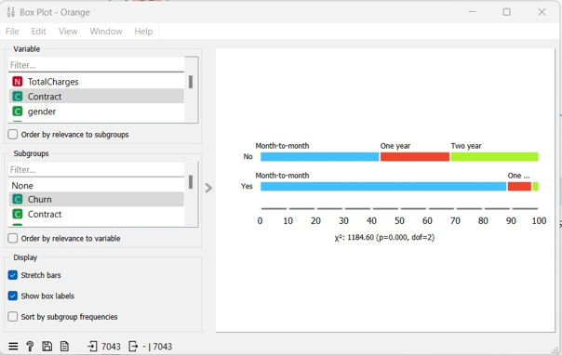
31
Box Plot
Contract and Churn

Slide 32
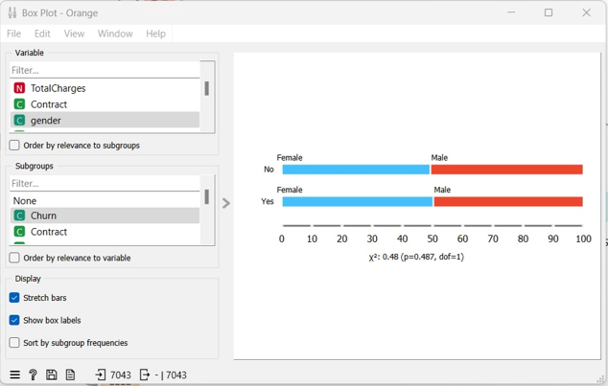
32
Box Plot
Gender and Churn

Slide 33
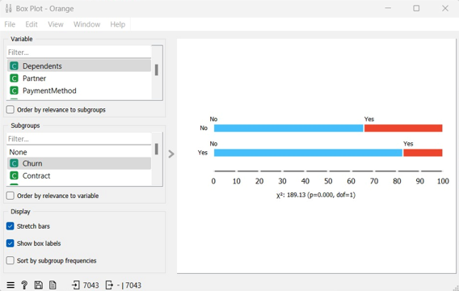
33
Box Plot
Dependents and Churn

Slide 34
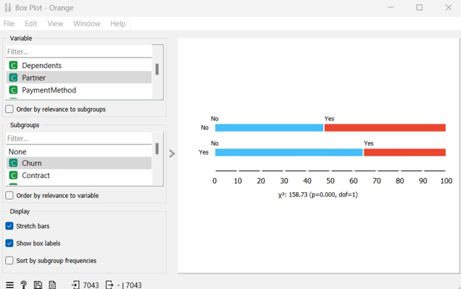
34
Box Plot
Partner and Churn

Slide 35
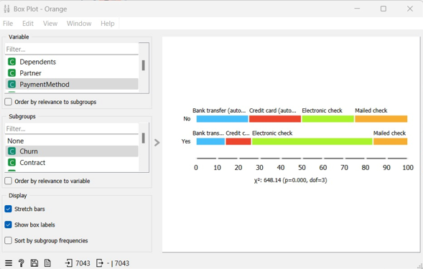
35
Box Plot
Payment Method and Churn

Slide 36
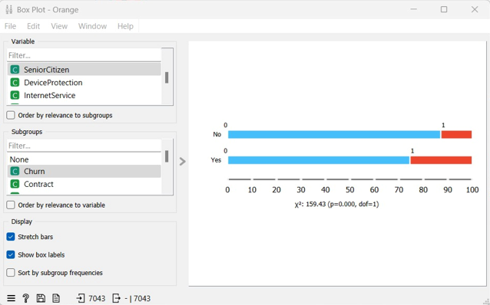
36
Box Plot
Senior Citizen
and Churn

Slide 37
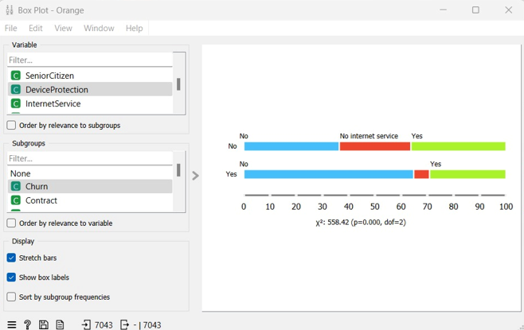
37
Box Plot
Device protection and Churn

Slide 38
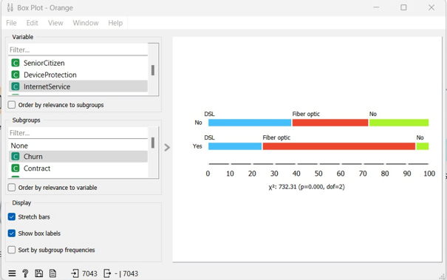
38
Box Plot
Internet Service and Churn

Slide 39
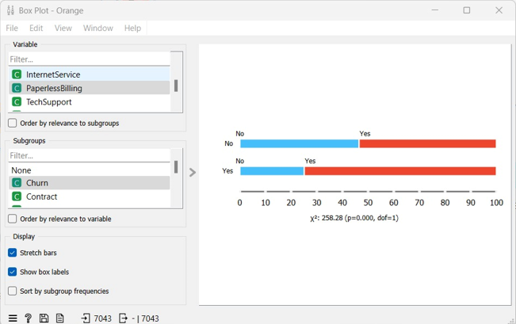
39
Box Plot
Paperless Billing and Churn

Slide 40
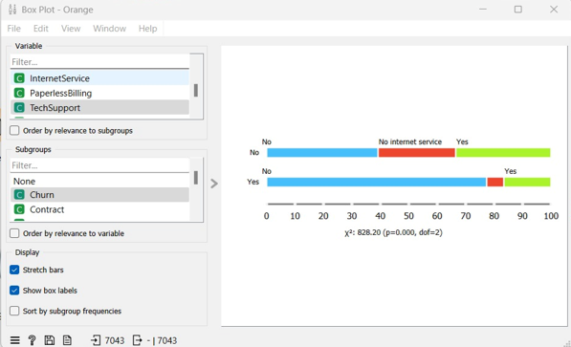
40
Box Plot
Tech Support
and Churn

Slide 41
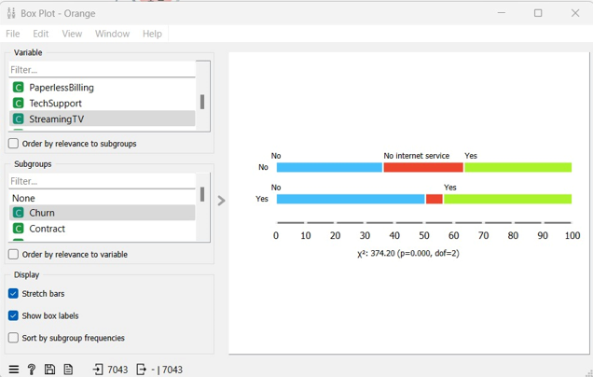
41
Box Plot
Streaming TV
and Churn

Slide 42

42
Box Plot
Streaming Movies
and Churn

Slide 43
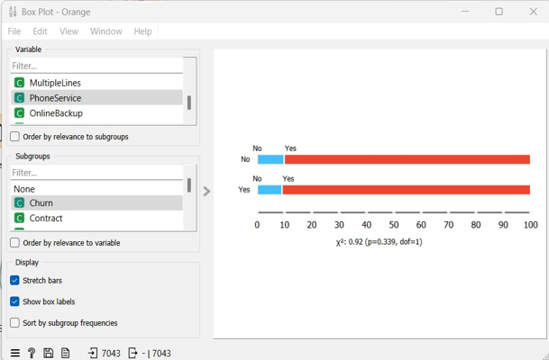
43
Box Plot
Phone Service and Churn

Slide 44
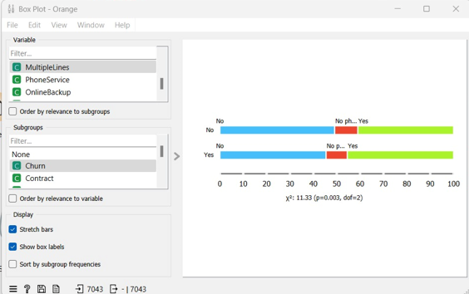
44
Box Plot
Multiple Lines
and Churn

Slide 45
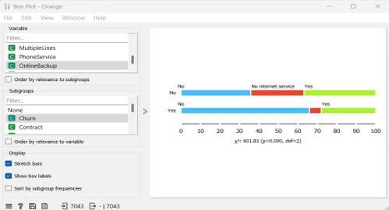
45
Box Plot
Online Backup
and Churn

Slide 46
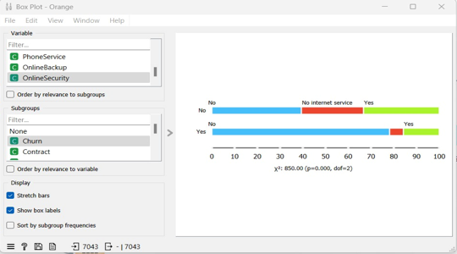
46
Box Plot
Online Security
and Churn

Slide 47
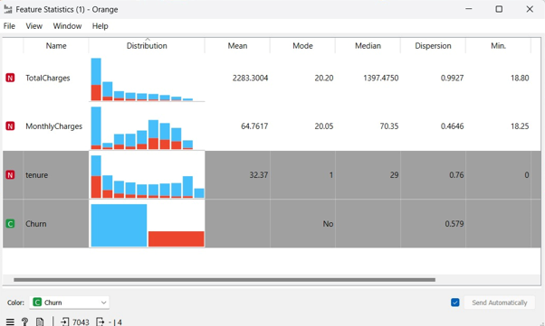
47
Feature Statistics
Total Charges
Monthly Charges
Tenure
Churn

Slide 48
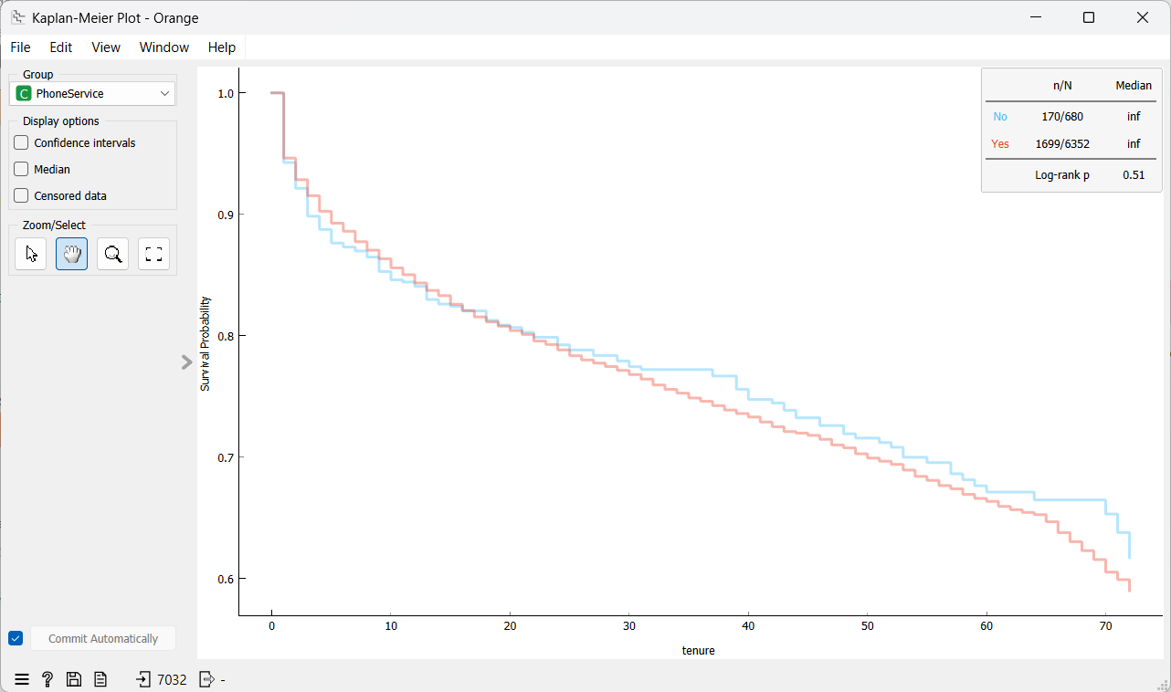
48
Kaplan-Meier Plot
Phone Service
and Tenure

Slide 49
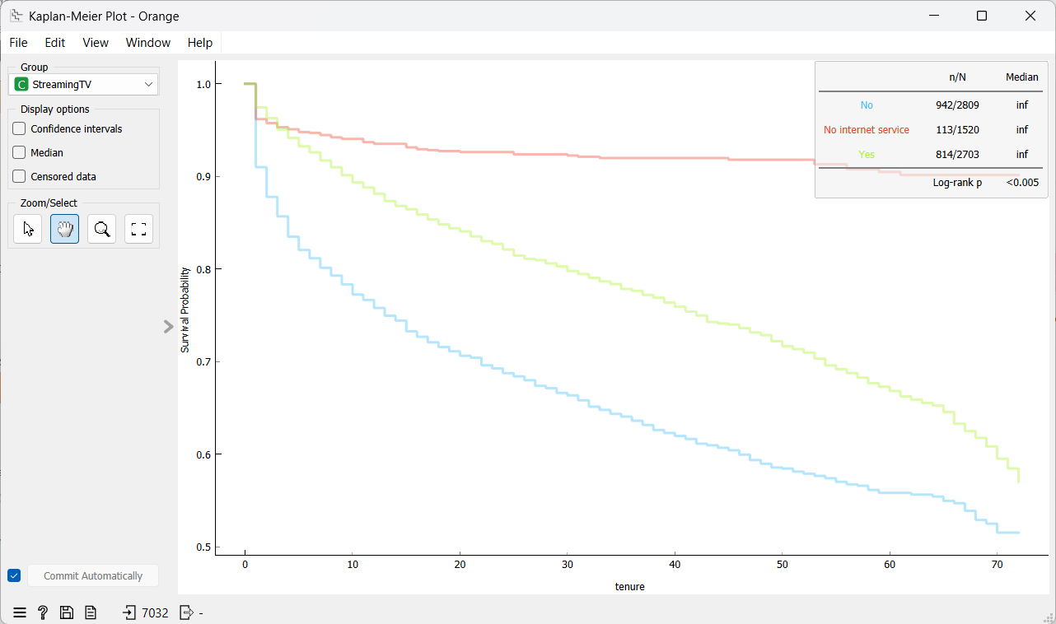
49
Kaplan-Meier Plot
Streaming TV
and Tenure

Slide 50
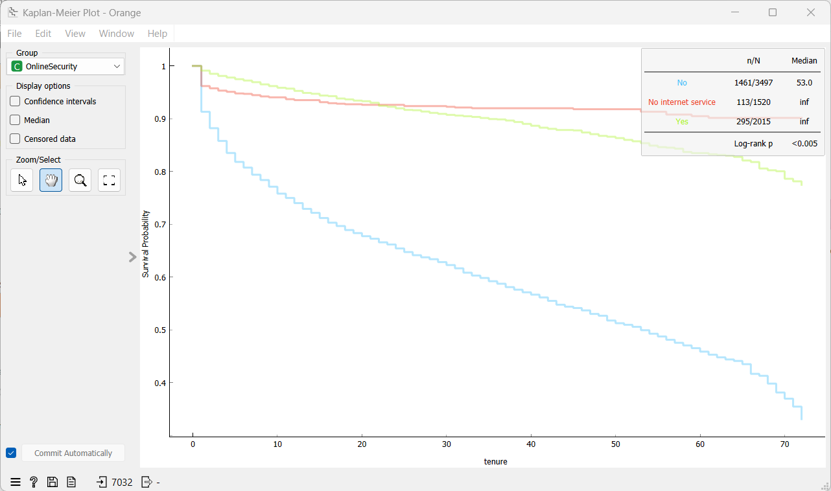
50
Kaplan-Meier Plot
Online Security
and Tenure

Slide 51
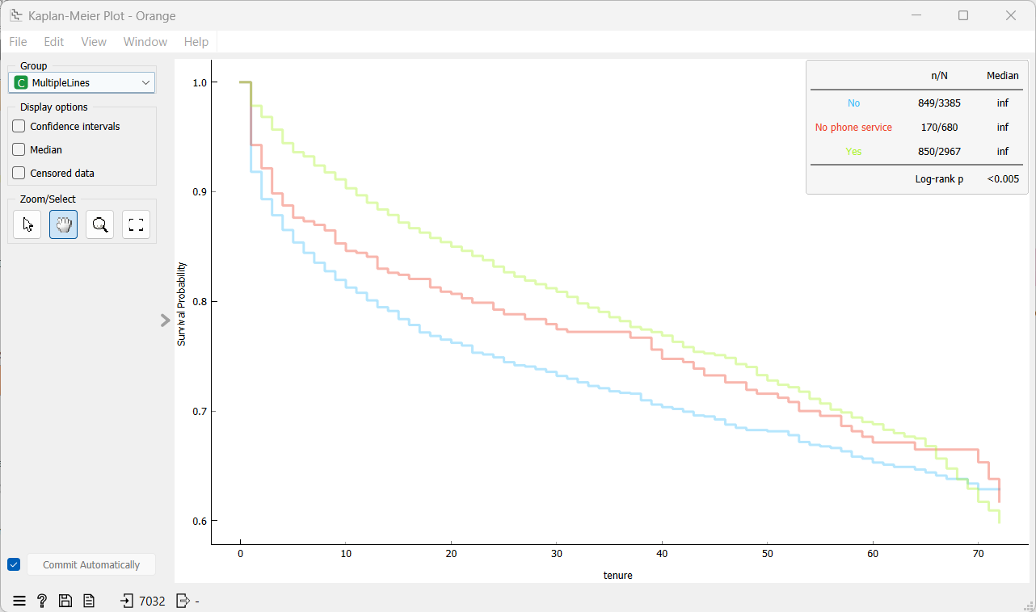
51
Kaplan-Meier Plot
Multiple Lines
and Tenure

Slide 52
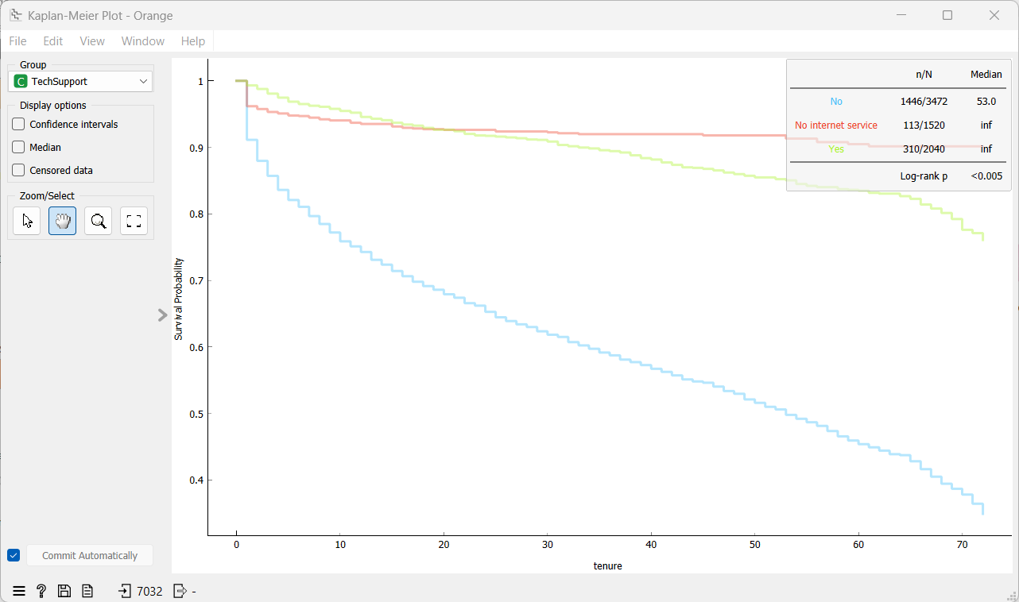
52
Kaplan-Meier Plot
Tech Support
and Tenure

Slide 53
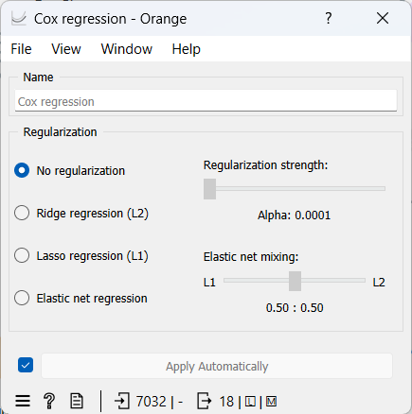
53
Cox regression

Slide 54
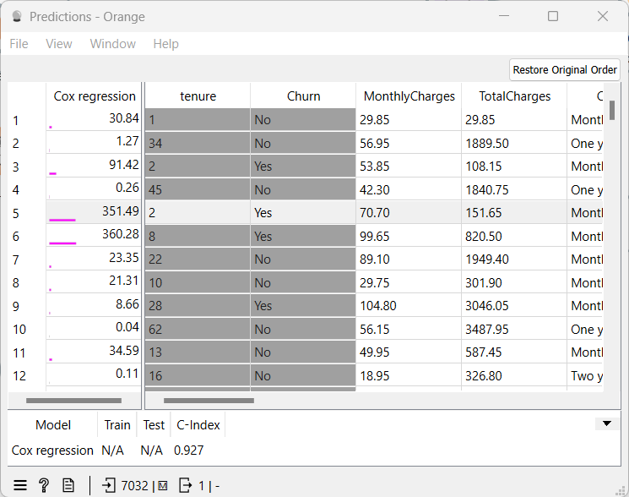
54
Predictions

Slide 55
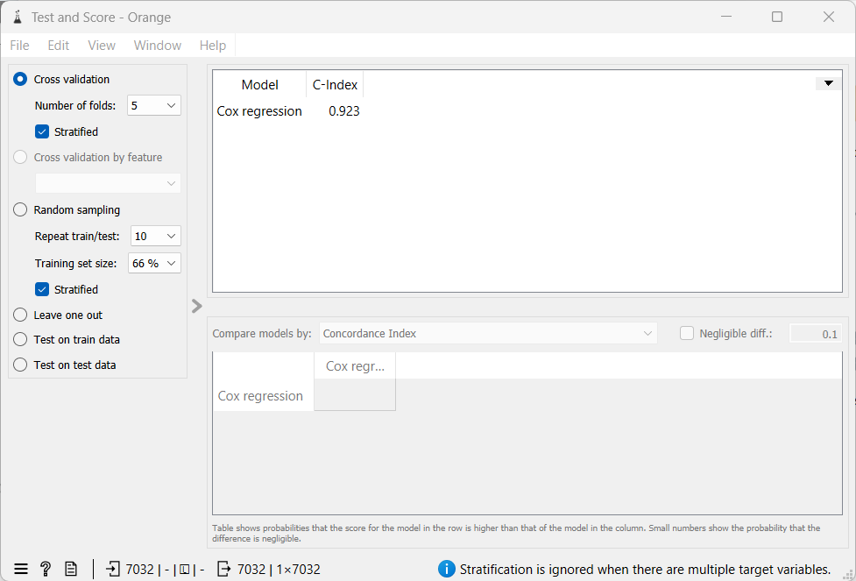
55
Test and Score

Slide 56
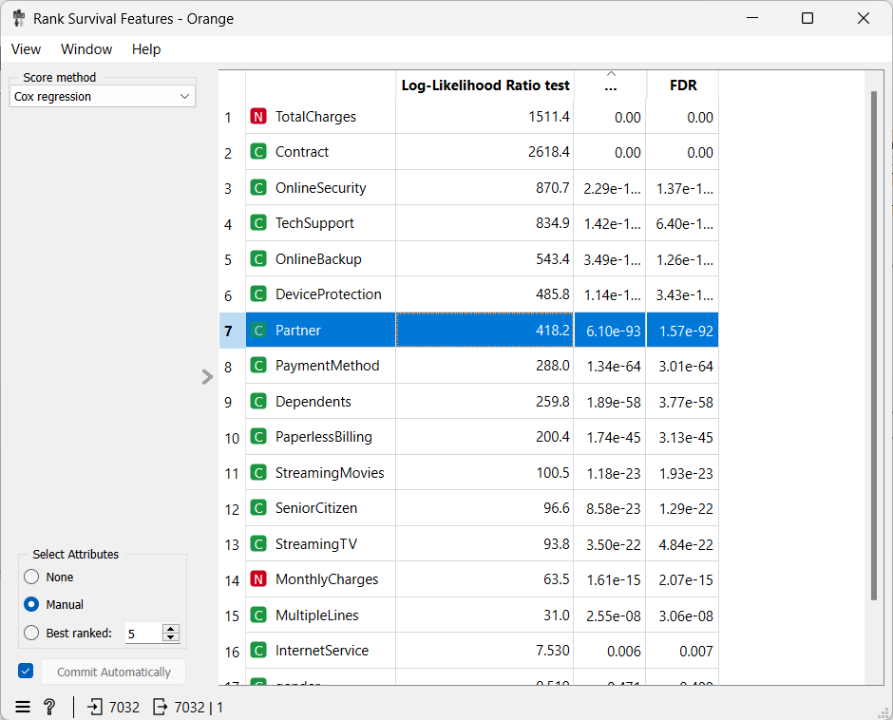
56
Rank Survival Features

Slide 57
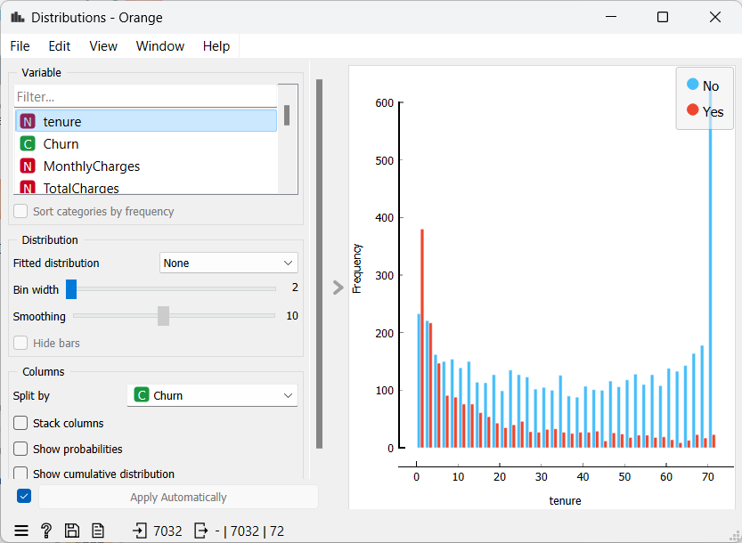
57
Distributions

Slide 58
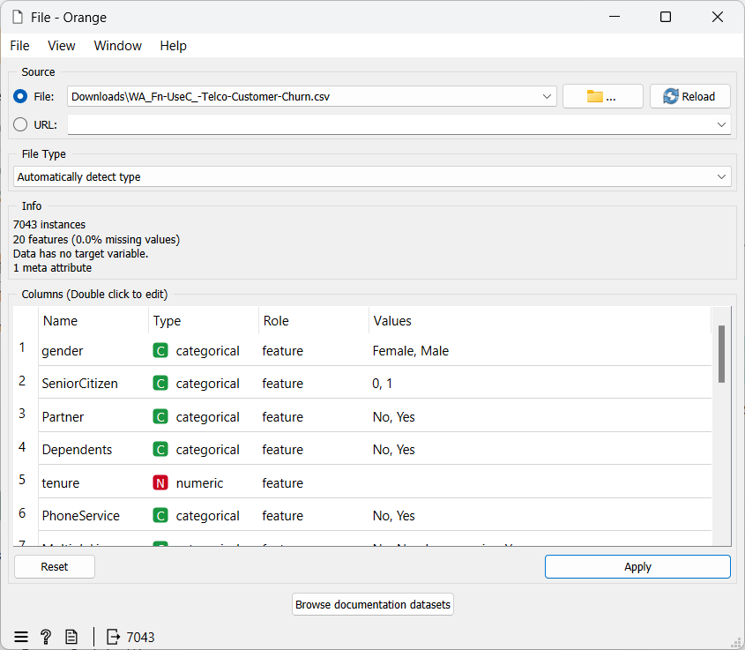
58
File

Slide 59
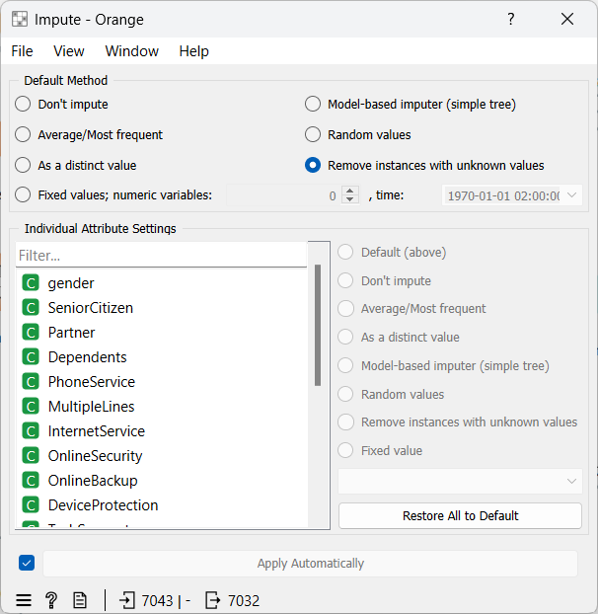
59
Impute

Slide 60
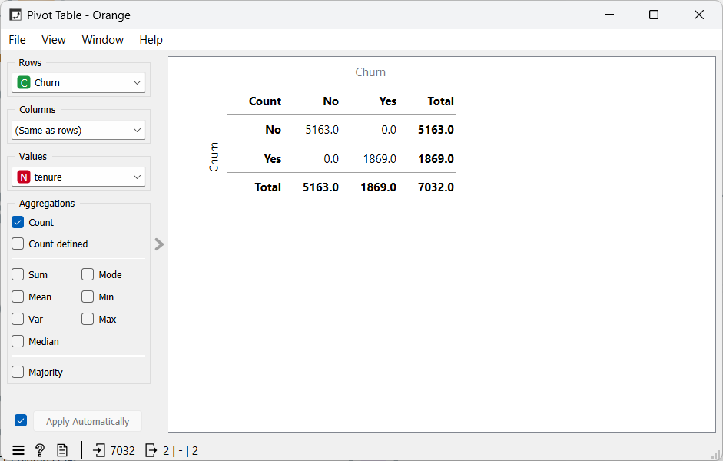
60
Pivot Table

Slide 61
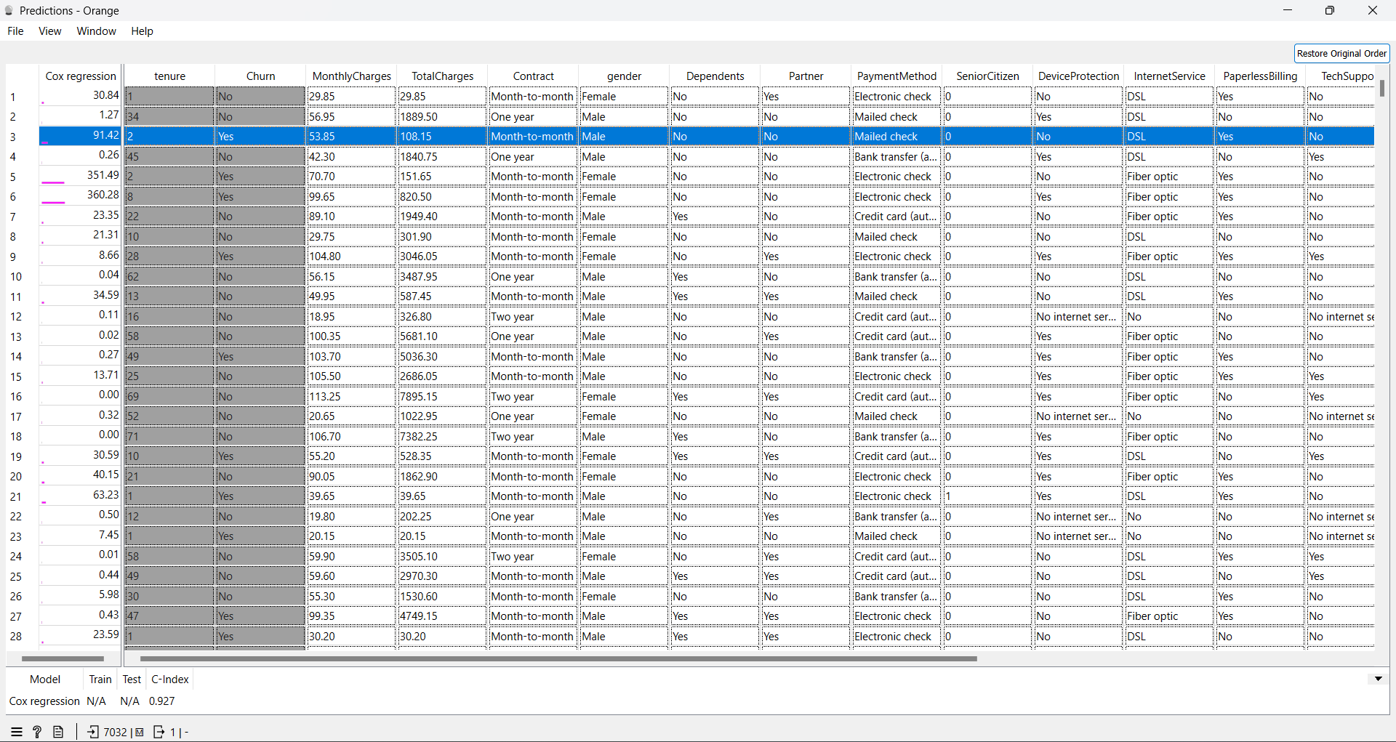
61
Predictions

Slide 62
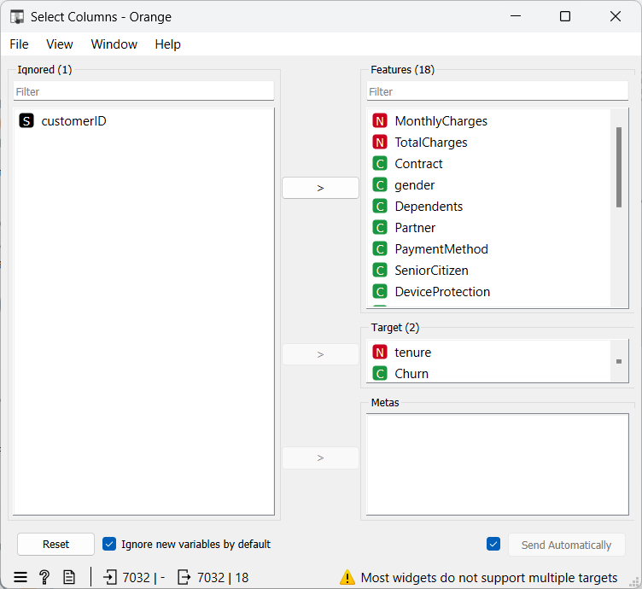
62
Select Columns

Slide 63
63
09
Future Work

Slide 64
64
Improve the accuracy of models.
Increase data size.
Integration with existing systems.
Update models regularly.
Future
Work

Slide 65
65
10
Conclusions

Slide 66
66
Predicting customer churn using machine learning provides businesses with a robust toolset for understanding and mitigating the risk of losing customers. The key conclusions derived from implementing this approach are as follows:
Enhanced Customer Insights, Data-Driven Understanding, Feature Importance, Improved Predictive Accuracy, Model Selection and Optimization, Continuous Learning, Revenue Growth, Cost Efficiency
Conclusions

Slide 67
67
11
References

Slide 68
References
68
https://www.ncl.ac.uk/webtemplate/ask-assets/external/maths-resources/statistics/regression-and-correlation/simple-linear-regression.html
https://www.ibm.com/topics/logistic-regression
https://www.ibm.com/docs/en/spss-statistics/saas?topic=statistics-cox-regression-analysis
https://medium.com/co-learning-lounge/types-of-data-analytics-descriptive-diagnostic-predictive-prescriptive-922654ce8f8f
https://www.kaggle.com/datasets/blastchar/telco-customer-churn

Slide 69
References
69
Verbeke, W., Martens, D., Mues, C., & Baesens, B. (2012). Building comprehensible customer churn prediction models with advanced rule induction techniques. Expert Systems with Applications, 39(17), 1-9.
https://youtube.com/playlist?list=PLYW0LRZ3ePo7TpIVGYjFbUfCICkTxwU7p&si=o6XbyigXiyK66M_o
https://orangedatamining.com/
https://github.com/biolab/orange3
https://www.youtube.com/channel/UClKKWBe2SCAEyv7ZNGhIe4g

Slide 70

70

